Slide 1
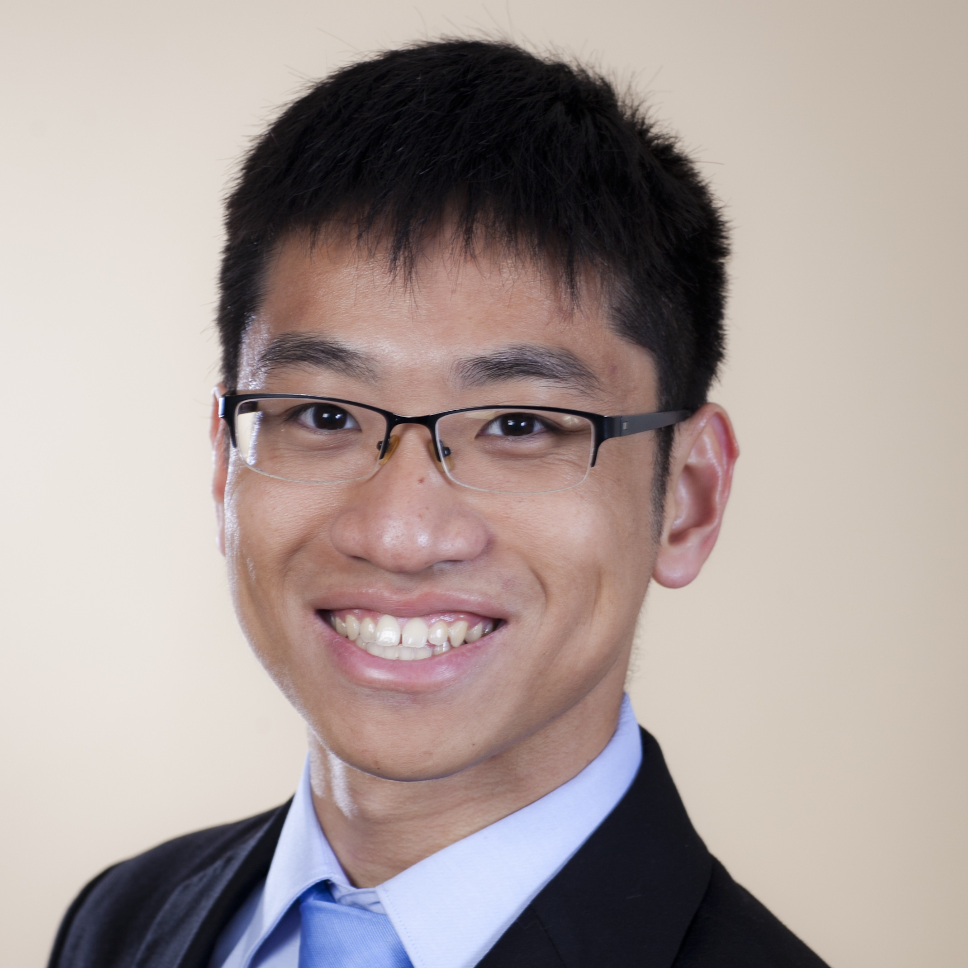
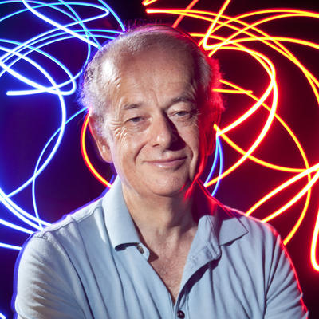
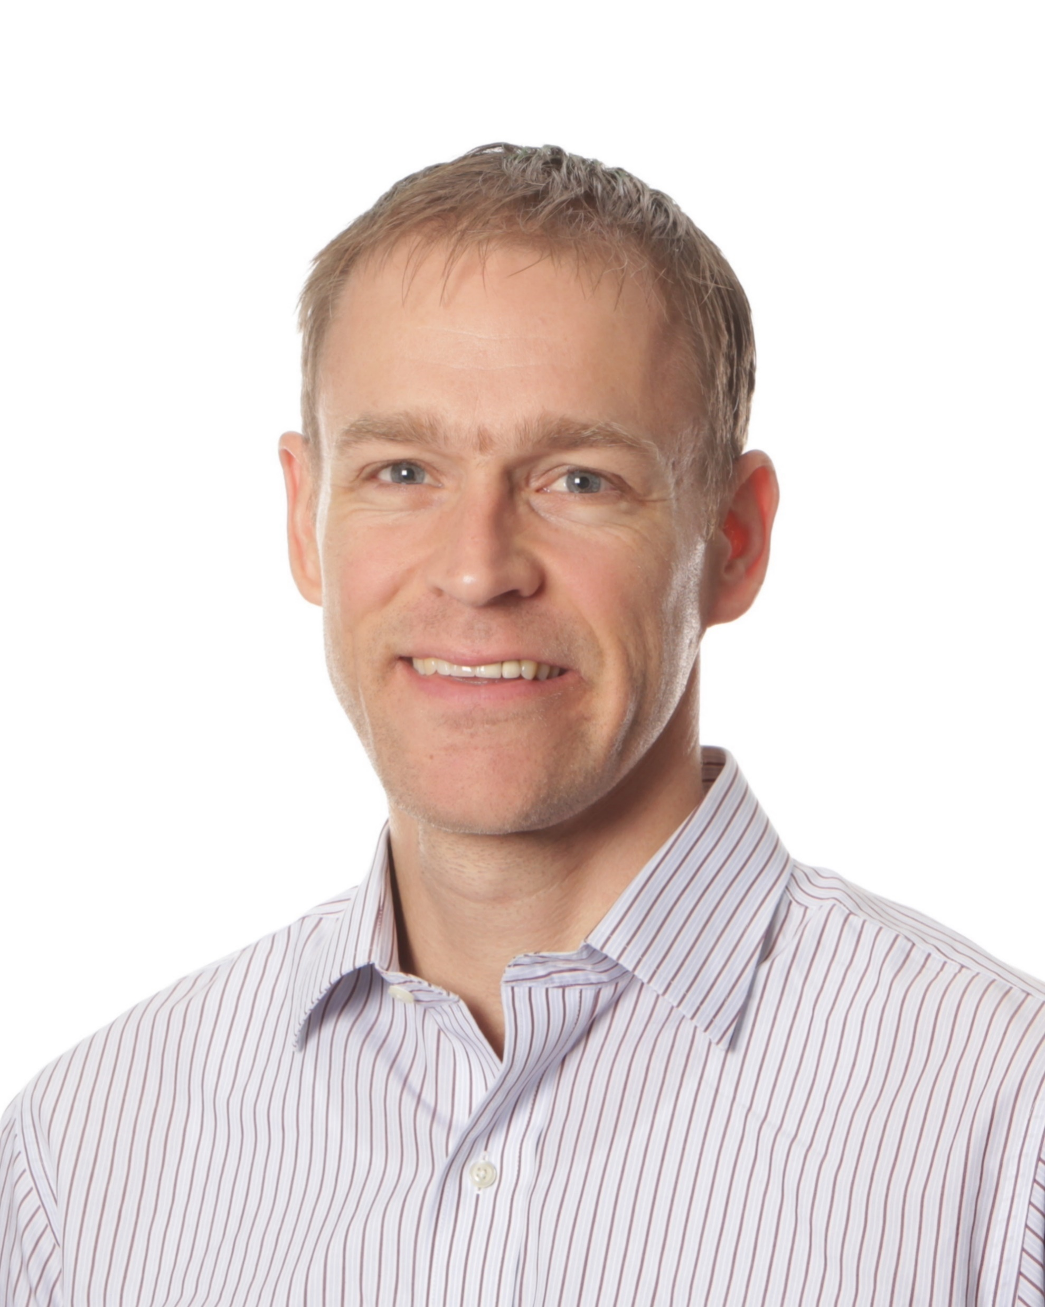
Polarization Multi-Image Synthesis with Birefringent Metasurfaces
Dean Hazineh*, Soon Wei Daniel Lim*, Qi Guo, Federico Capasso, Todd Zickler
Harvard University, School of Engineering and Applied Sciences

Slide 2
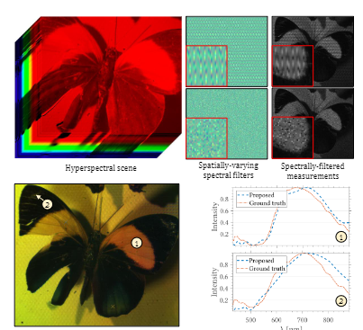
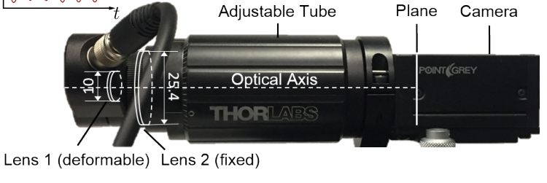
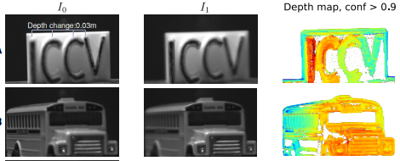
Motivation: Computing with Sets of Images
All computational imaging tasks benefit from the capture and processing of multiple images
Sets of images captured from the same viewpoint but with different optics
Sets of images captured from different locations
Simpler algorithms
Less training data
Better accuracy
Depth-Sensing from Defocused Images
Hyperspectral Imaging with SLM
(t=$t_{0}$)
(t=$t_{1}$)
(t=$t_{0}$)
(t=$t_{1}$)
https://www.optotune.com/machine-vision
Saragadam V. et al, Programmable Spectral Filter Arrays using Phase Spatial
Light Modulators, arxiv 2021
Guo, Q. et al., International Conference on Computer Vision (ICCV). IEEE (2017).
Notes:
The motivation for this work is based on the simple idea that all computational imaging tasks benefit from the capture and processing of multiple images
Now this refers to sets of images that are captured from the same viewpoint, meaning the same camera location, but with different optics
Although historically it has also referred to multiple images captured with the same camera but at different viewpoints
Throughout this talk however we will only be focusing on this first case.
Now again, the idea is that if we want to extract additional information about the scene using our camera images, say a depth map, a segmentation mask, or a hyperspectral datacube,
[CLICK]
we can do so with simpler algorithms, less training data, and often better accuracy if we are processing set of distinct images instead of just one.
This paradigm of computing on multiple images has appeared throughout the long history of computational imaging and as a concrete example, you can observe its application to the task of depth-sensing from defocused images. The camera is show on the right and it contains a deformable lens paired with a standard photosensor.
By applying a voltage the shape of the lens is physically deformed and its focal length is shifted to a different depths.
One can then obtain a set of coded measurements by capture multiple images sequentially over time while deforming the lens. Pulled from the original paper, you can see an example of two images, I0 and I1, that are measured for a static scene. When the pair of images are passed to a post processing algorithm, you can obtain a depth map for orders of magnitude less computation.
As one additional example, this paradigm is also applied to hyperspectral imaging. Here, the dynamic optic is instead a spatial light modulator and by changing this component, different spectral filters can be applied to the captured images. Using a set of measurements taken sequentially over time, one can reconstruct the hyperspectral datacube for the static scene with less computationa and better accuracy than when using a single image.

Slide 3
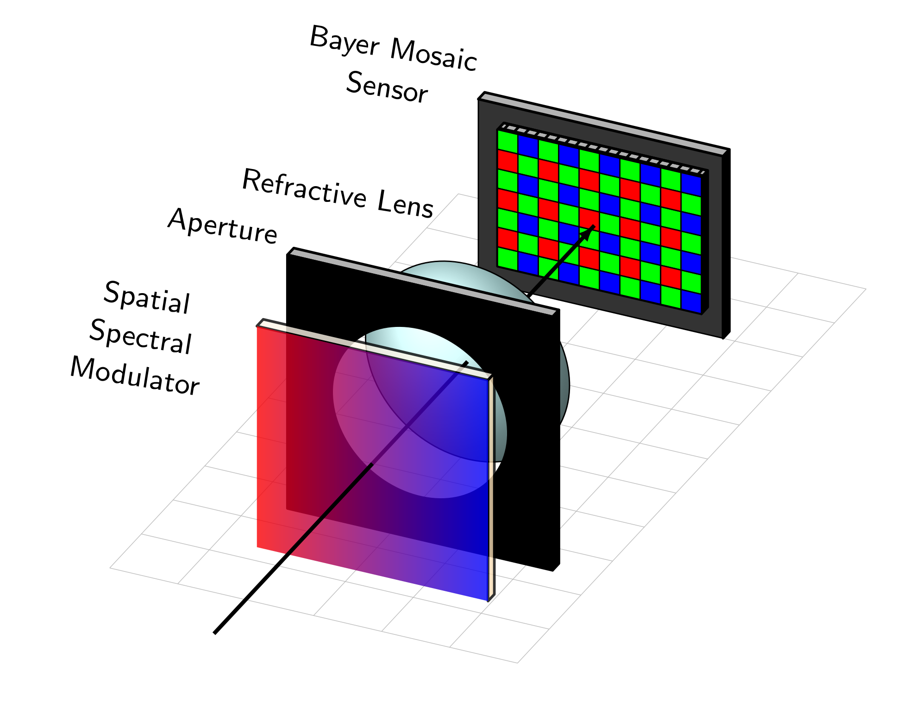
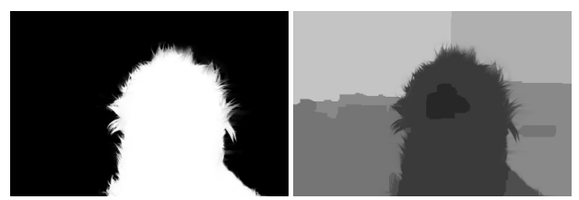
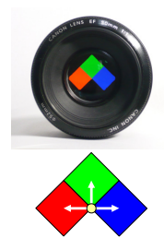
Snapshot Spectral Multi-Coded Imaging – Prior Works
Methods to capture multiple coded images in one exposure
Paradigm: Wavelength as separate imaging channels
Demosaic
measurement
Reconstruction
algorithm
Matte
Depth
Distinctly coded images on different wavelengths
Mosaic of spectral filters at the sensor to retrieve set
[1] Y. Bando et al., Extracting Depth and Matte using a Color-Filtered Aperture, ACM Trans. Graph. 2008.
(See also) A. Chakrabarti et al, ECCV 2012. (and) C. Corre et al., Journal of the Optical Society of America, 2015
Notes:
Now these previous method all captured multiple images sequentially over time, however, there is substantial interest in designing an architecture that can instead obatin the set of multiple images in a single exposure (in otherwords a single exposure). The benefit is that we could then apply these algorithms to scenes that are not static and we could extract information with a higher effective framerate.
One way to do this is with a general paradigm of using wavelengths as separate imaging channels. In this work, I classify imaging systems that use this idea as Snapshot Spectral multi-coded imaging systems and we have observed that systems that fall under this category have been heavily researched and developed for at least 30 years now.
The general design of these cameras can be summarized in the following schematic. Some spatially varying spectral modulator is placed at the aperture plane in front of a focusing lens. This optical component is essentially a wavelength dependent phase or transmission mask and it serves the purpose of producing distinctly coded images on different wavelengths of light.
These images are all spatially overlapping at the photosensor plane and so a mosaic of complementary spectral filters tiled above the sensor pixels are then used to simultaneously measure and demultiplex the signal. The most common case is the use of Bayer color filters in typical RGB cameras.
To give an example of what this optical component might look like in real life, it can be as simple as spectral filters in different locations although there are many other examples. Using this optic the authors referenced below capture a measurement that is then digitally demosaiced to obtain three distinctly coded images. These images are then passed to a post-processing algorithm to obtain a segmentation mask and depth map.

Slide 4
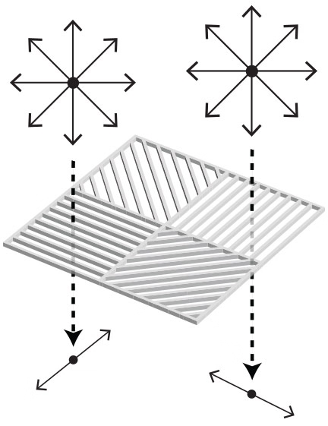
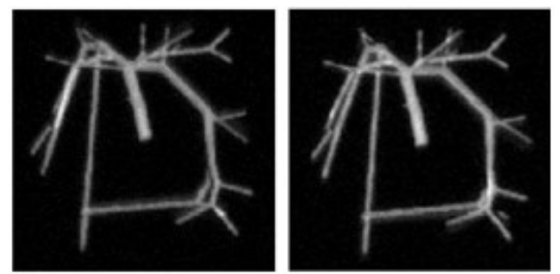
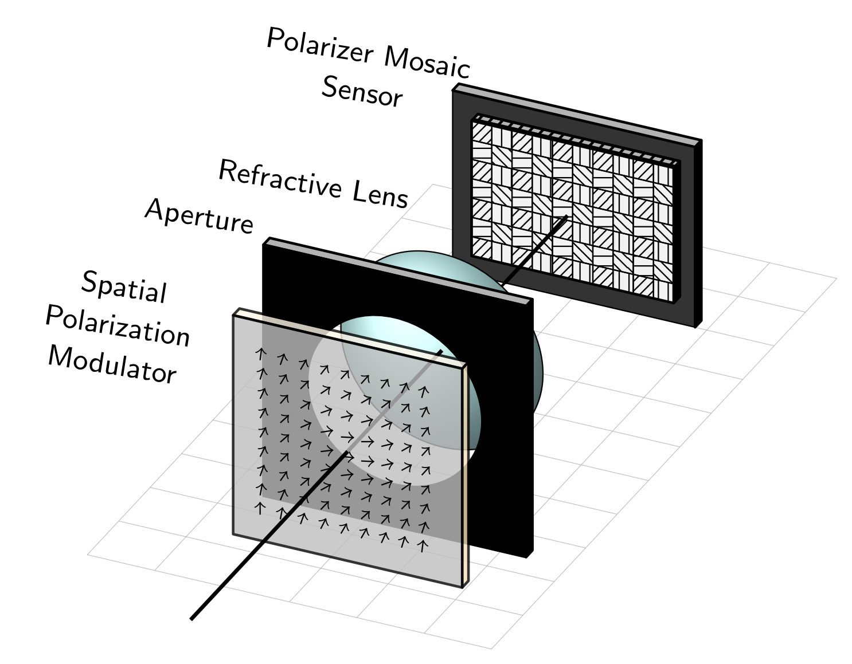
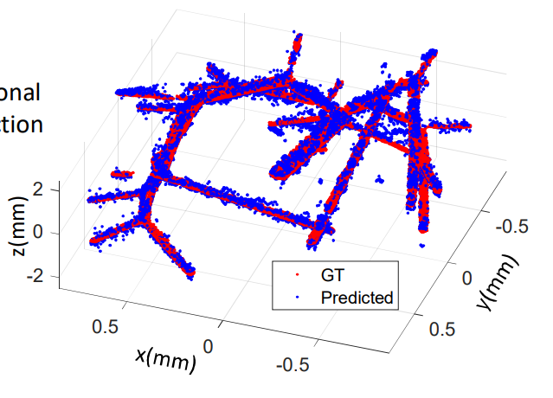
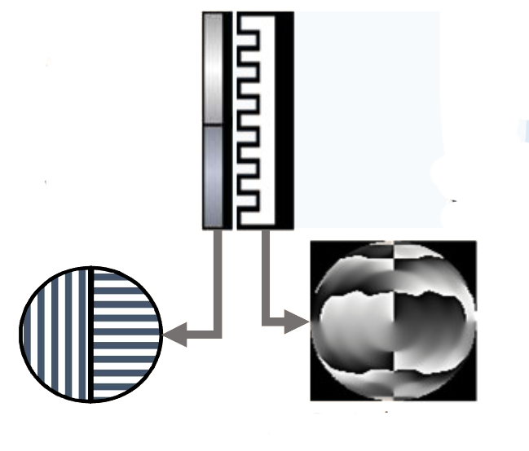
Snapshot Polarization Multi-Coded Imaging – New Opportunities
Methods to capture multiple coded images in one exposure
New Paradigm: Polarization as imaging channels
Demosaic
measurement
Reconstruction
algorithm
Super-resolution Depth
Formalize and understand this type of architecture
Can we use all four polarization channels for imaging?
What are the capabilities of this system?
[2] B. Ghanekar et al., “Ps2 f: Polarized spiral point spread function for single-shot 3d sensing,” ICCP 2022
Notes:
This idea of spectrally encoding multiple images and measuring them in a single snapshot using a detector side filter array has been applied to many tasks. However, the development of new technology has now opened the door for a different way to approach the same problem.
Specifically, there is an opportunity to now consider the paradigm of using polarization as distinct and multiplexed imaging channels. The general schematic for these systems are very similar but instead of a mosaic of spectral filters above the photosensor’s pixel, we now employ an array of linear polarizers. Analogous to before, we classify systems of this type as snapshot polarization multi-coded imaging systems.
It is worth noting that photosensors with a 2x2 tiling of polarizers at four different angles as shown here has become commercially available over the last five years and can be purchased at just about any optics retailer. Paired with the focusing lens, we one can then utilize a spatially varying polarization mask instead of the spectral mask which results in distinct images carried on different polarization states.
Although there are a number of advantages in consider the use of polarization, either in place of or in conjunction with spectral coding, systems of this design have surprisingly been largely unexplored. To date, there is only one other work at the time of this publication that has considered designing a multi-image computational imager of this form and that is from this group referenced below at Rice University.
Although their imaging system had a slightly different setup, it is instructive to view it in this form. Their optic consisted of two linear polarizers that transmits either 0 or 90 degrees polarized light. These two polarizers are then place placed on two different halves of a phase mask. After measuring and demosaicing the intensity at the photosensor, two of the four images (I0 and I90) are used with a reconstruction algorithm to obtain a super-resolution depth map. By having two optically coded images instead of just one, they demonstrated substantial improvements in accuracy relative to single-image systems.
Now the heart of this work is to delve much deeper into systems of this general design and to present it more formally, In doing so, we try to rraise and answer two fundamental questions:
The first is, can we design and use all four polarization channels for computational imaging tasks instead of just two and is there motivation to do so.
The second is, what are the general capabilities and potentials for systems that leverage this paradigm.

Slide 5
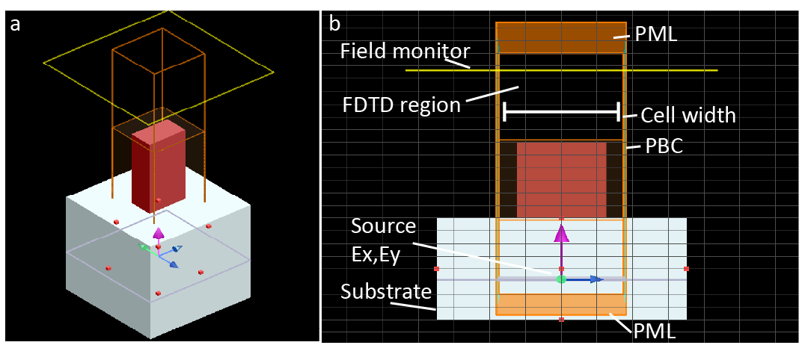
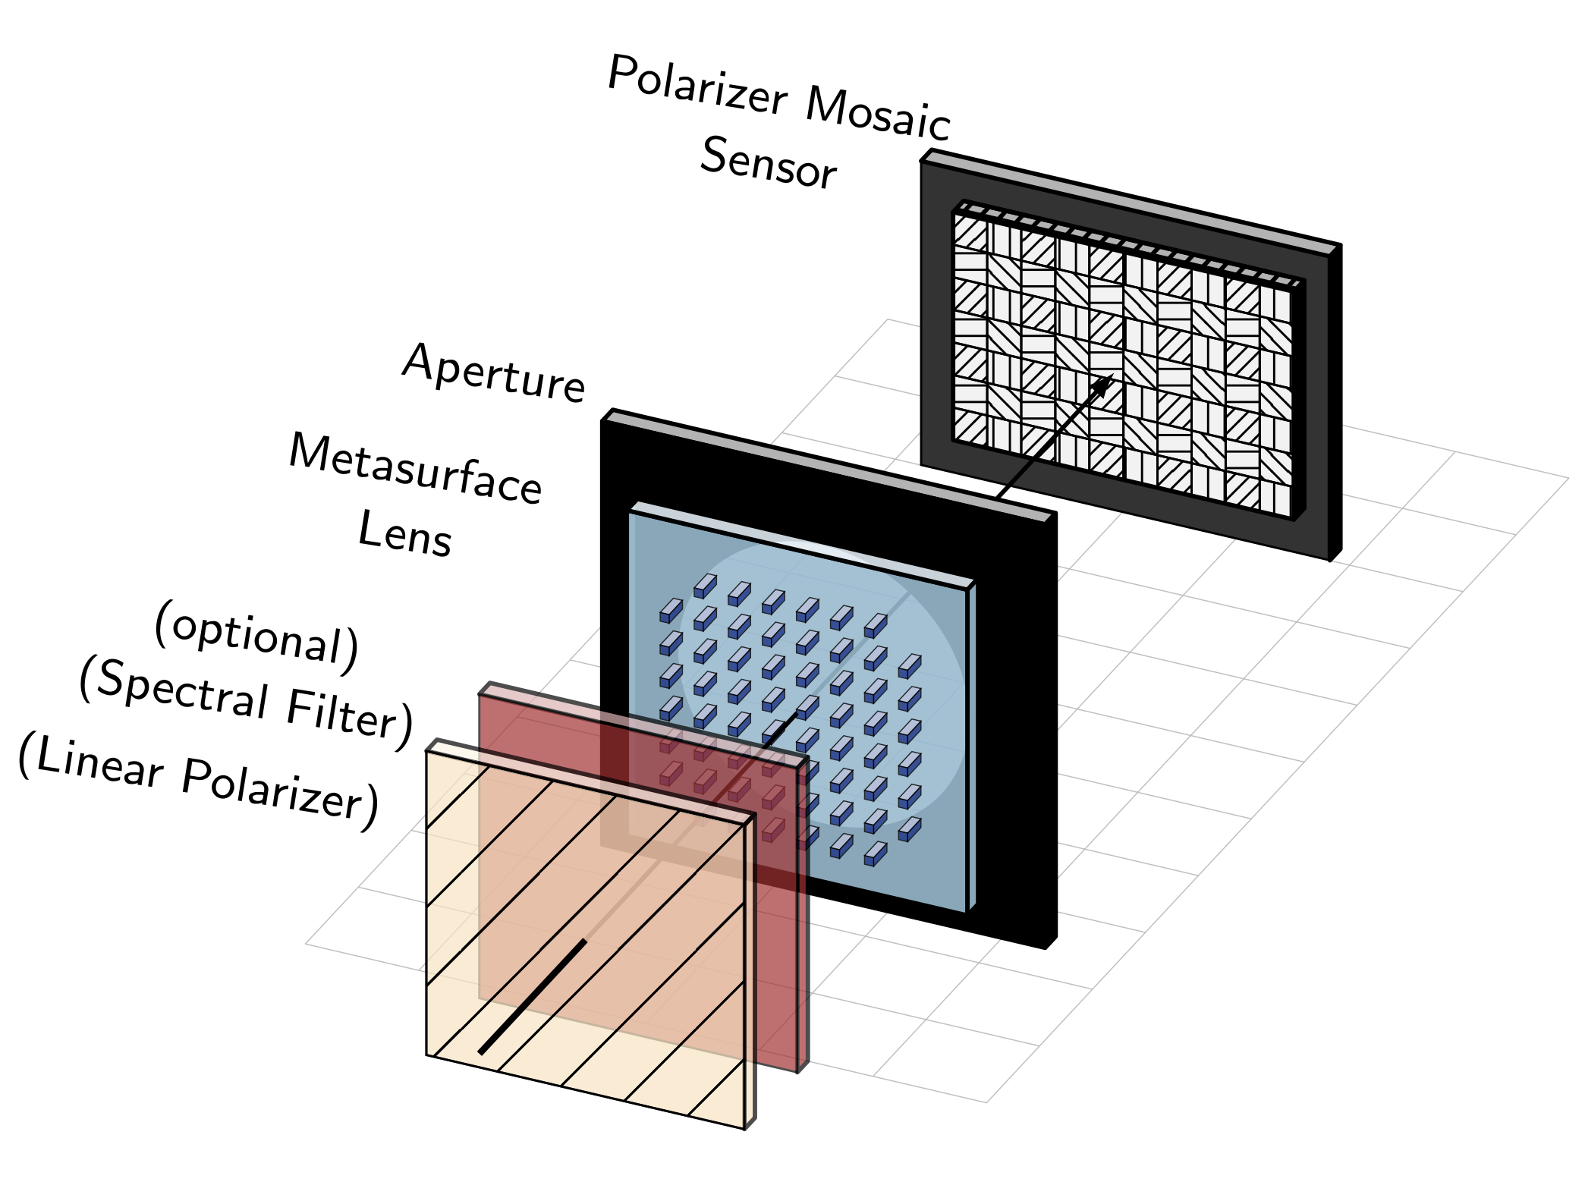
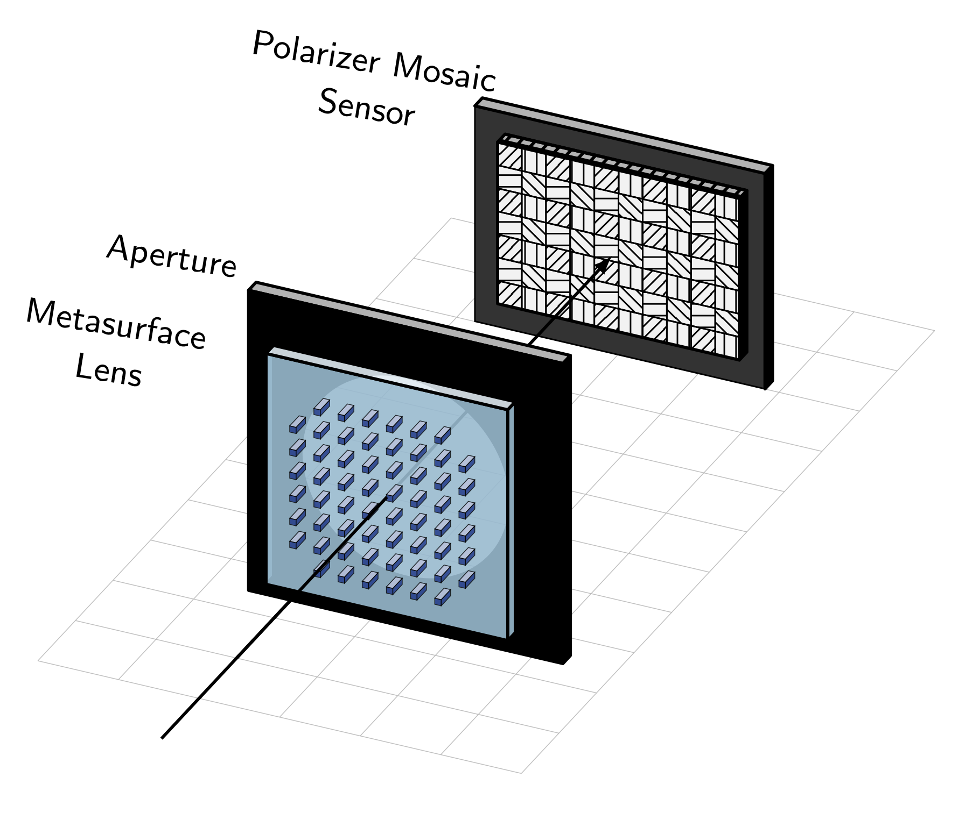
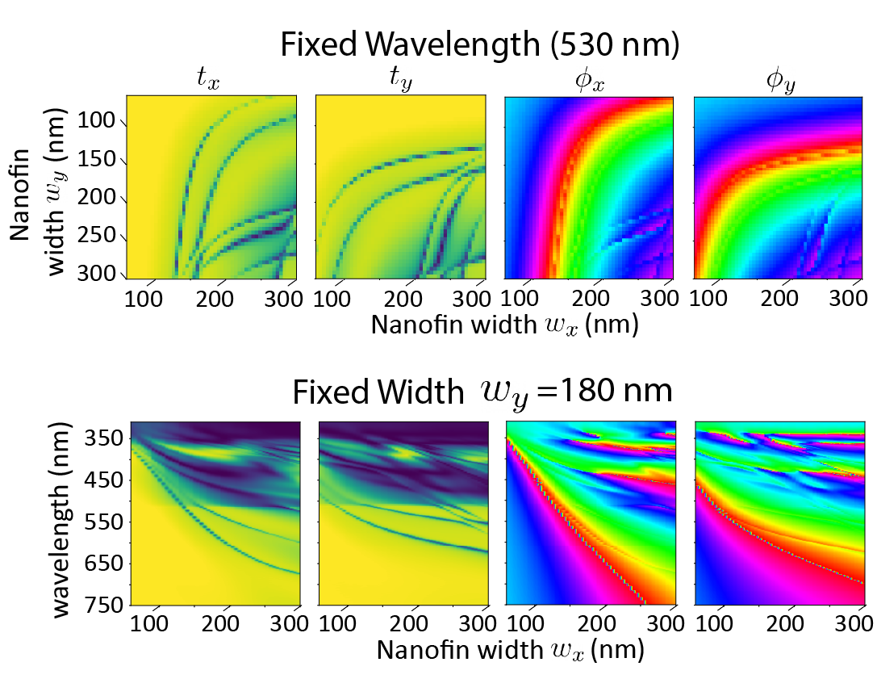
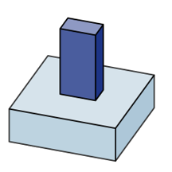
Creating the System with Birefringent Metasurfaces
Snapshot Polarization Multi-Coded Imaging – New Opportunities
Proposed metasurface-based architecture
Cell design theory (review)
350 nm
(fixed)
Notes:
Now in order to answer this question about the capabilities and potentials of optical systems like this, we need to first frame its design in terms of some particular choice for the optics.
And in this work, we propose the use of dielectric metasurfaces (occasionally preceeded by a spectral filter or linear polarizer to simplify the discussion) . The metasurface combines the role of both the focusing lens and the optical modulator into one single, ultrathin flat optic lens and it is perhaps singularly capable in its ability to produce spatially varying polarization transformations.
Metasurface are a new class of recently matured optical elements that consist of carefully enegineered nanostructures patterned on the surface of a flat, transparent substrate. An image of a real metasurface is shown here, captured using a scanning electron microscope since the size of the patterend structures are smaller than the wavelength of light.
The key idea of a metasurface is that the phase delay imparted to an incident wavefront that passes through the nanostructure depends on shape of the structure. By changing the shape at a given location, we can change the phase delay and to a lesser extent, the amount of light that is transmitted at that spot. Importantly, if the nanostructure’s shape is anisotropic like with the nanofins used in this work, then the phase delay and transmittance becomes polarization dependent. By judiciously selecting the nanostructure that is placed at each location across the lens, we can then structure the entire incident wavefront such that it gets focused to a single point at the photosensor or to form user defined intensity patterns.
Now we know that the shape of the nanostructure general defines its optical response but how do we quantify it exactly. To do this, we have to consider each possible nanostructure shape in isolation and compute its interaction with light by solving Maxwells equations. Specifically, we use a field solver create a dataset mapping the nanostructure shape, in this case the width of the nanofin along two directions, to the phase delay and transmittance that is imparted to two polarization states. A slice from this dataset is shown here where each point corresponds to a different nanofin instantiation. As a note which will come up again later, this optical response is also strongly wavelength dependent in a way that is unique for each structure and so we have to run this simulation for all wavelengths we want to consider.

Slide 6
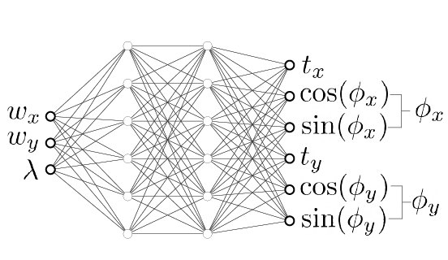
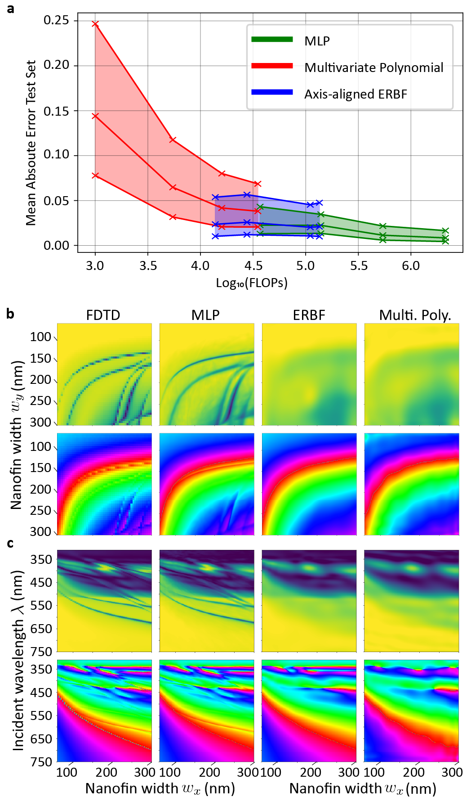
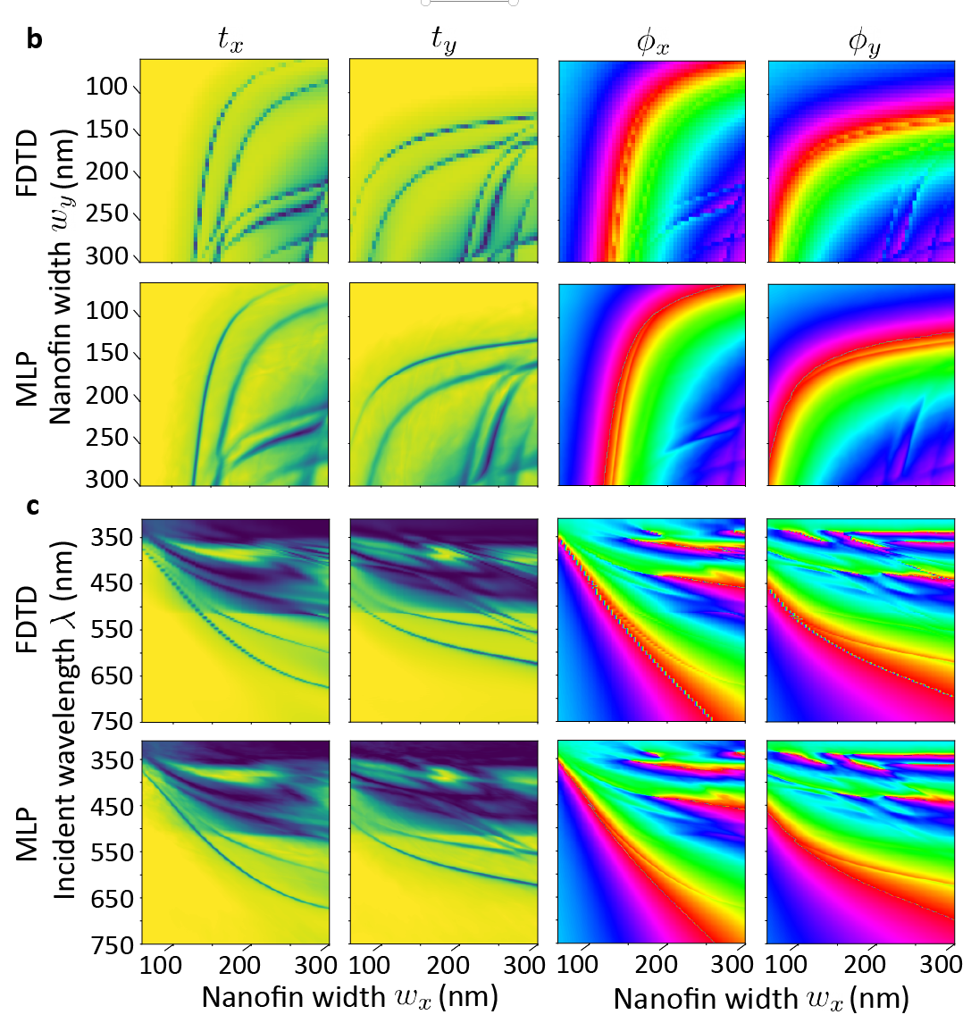
Neural Representation for Gradient Based Optimization
Cell design theory (review)
Notes:
Using this dataset, we can define what a metasurface composed of nanofins does in terms of functionality but it doesn’t immediately give us any method to design the device or to optimize its performance. This ability is of course necessary if we want to probe the capabilities of a system for a given task.
In order to enable gradient based optimization of our lens alongside our post-processing algorithms, we need to introduce a differentiable representation for this mapping. In this work, we also propose the use of a simple MLP (also known as a multi-layer perceptron) to learn the mapping between nanostructure shapes and the optical response, as shown here.
We find that a simple design with just two hidden layers and ReLu activation is sufficient to almost perfectly reproduce this mapping. Here, you can visually compare the MLP predictions on an upsampled grid to the coarsely sweeped training data. As a note for those who are familiar, recent work on Nerf and coordinate MLPs tells us that these neural representations can be improved by adding a fourier features embedding at the input of the network but we found good performance for this simple dataset even without it.
Once this network is initially trained, its weights are then frozen. Now throughout this talk, when we mention optimizing the metasurface, we are referring to utilizing auto-differentiation and back-propagating the gradients through this frozen MLP in order to optimize the set shape parameters, that is the nanofin width wx and wy, at every location on the metasurface.
Lastly, I want to highlight that there are other trainable functions that could be used as implicit representations and we considered a few other options for this work. In addition to the MLP, we tested using a set of multi-variate polynomial functions to represent the mapping in addition to using elliptic radial basis function networks. These two other representations both require less computation per inference evaluation, but, in all cases, we found these other methods to be substantially less accurate. You can see in this panel below that only the MLP was able to reproduce the sharp details in this slice of the dataset.

Slide 7
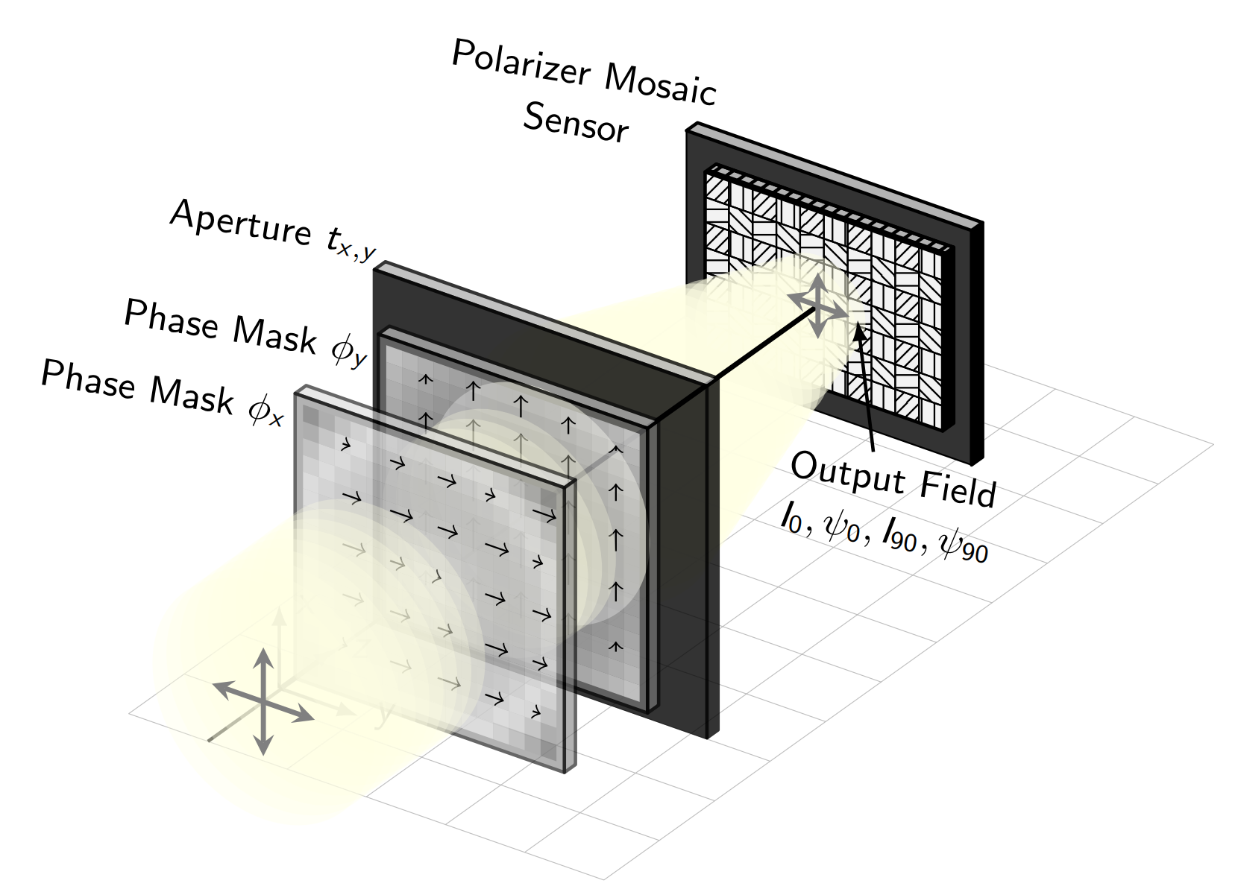
Fundamental Channel Capacity -- Interference of Polarized Light
How many coded images can we engineer and measure with the polarization architecture?
→ # of intensity patterns we can make
Demosaic
measurement
If we fix the intensity distributions $I_{0}, I_{90}$… Can we control the intensities $I_{45}, I_{135}$ by optimizing the interference?
Phase at sensor plane
The Rigorous Answer: No…
Specifying the intensity of light at the aperture and the sensor plane fixes its phase at both planes
Notes:
Now before we continue further, we can take a moment and answer one of the initial questions that we raised about the polarization multi-image paradigm. Given the design of the camera and the use of a polarization-sensitive metasurface, what is the channel capacity of this imaging system. In other words, how many coded images can we directly engineer and measure?
Let us recall that in the spectral case discussed previously, the answer was unambigous. With the red green and blue spectral filters, we could clearly capture three distinctly coded images since different wavelengths of light do not interfere with each other. In the polarization multi-coded imaging scenario, the answer is less clear because we will have to consider the interference of polarized light.
In this discussion let us simply assert that the number of distinctly coded imaging channels accessible to us corresponds to the number of intensity patterns that we can independently design when our camera is illuminated by a beam of light. This situation is qualitatively shown below. For conceptual simplicity, we may approximate the polarization-sensitive metasurface as a pair of independent, idealized phase masks, where each mask imparts a different phase modulation to one of the orthogonal linear polarization states, say 0 and 90 degrees.
With this pair of masks, we then know that we can independently design the intensity at the photosensor simultaneously for 0 and 90 degree light and retrieve the images of I0 and I90. We have to remember that light also has a phase when it arrives at the photosensor in addition to the intensity and for this discussion, these quantities are important to keep track of..
With these four quantities defined, it turns out that the intensity pattern on the other two channels is fully specified. In fact the intensities I45 and I135 can be re-parameterized in terms of the interference shown by this equation. The question that we are left with is then: if we fix the intensity distributions on two channels, I0 and I90, can we still control the intensity on the other two channels perhaps by optimizing the interference.
Unfortunately the rigorous answer is No. By specifying the intensity at the aperture plane and the sensor plane for either 0 or 90 degree light, the phase of that light is then specified everywhere. And so in the strictest sense, the channel capacity is only two which means we should probably only ever use two images in our post-processing algorithm.

Slide 8
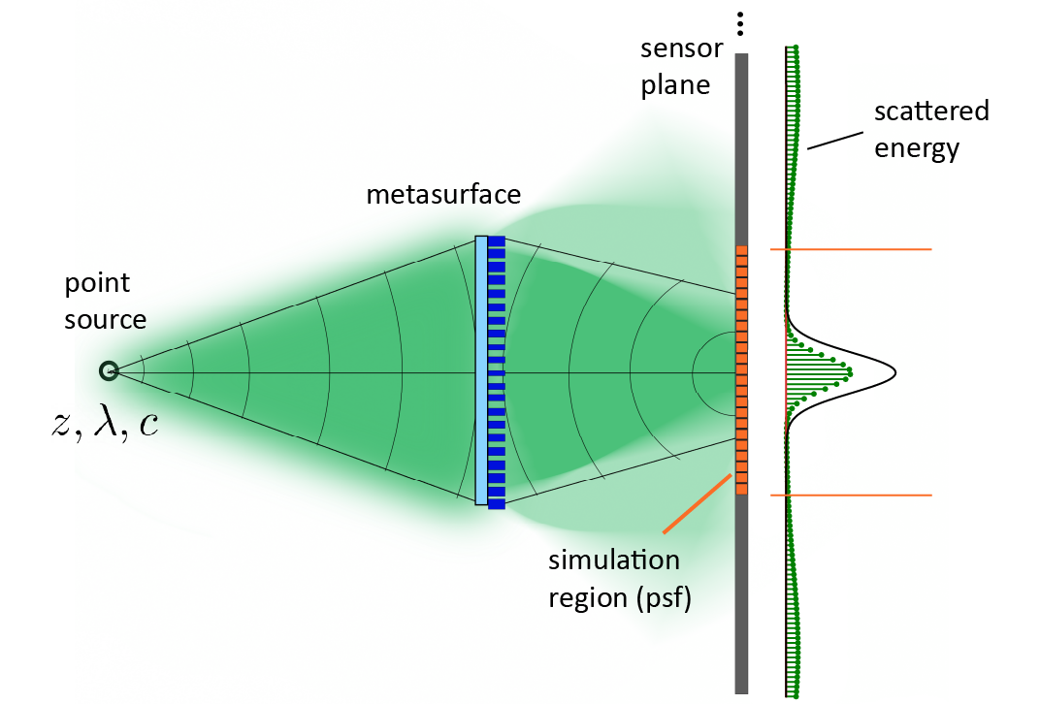
Fundamental Channel Capacity -- Interference of Polarized Light
The Practical Answer: Yes… if we compromise
$I_{0}, I_{90}:$There are an infinite number of possible intensity patterns that approximate the target distribution
Each one of these solutions has a different output phase → they can produce a different interference effect
Minimum error intensity approximation to uniform disk $I_{0}, I_{90}$
More error in intensity $I_{0}, I_{90}$ to structure interference
Different approximations:
Scattering light outside simulation region
Error in matching intensity within the region
In computational imaging, we generally care about codes that enable reconstruction vs exact patterns (end-to-end optimization)
Notes:
Alternatively, more important than the rigorous answer is the practical answer which is yes if we can make compromises. The key idea is that for each of I0 and I90, there are an infinite number of possible intensity patterns that approximate the target distribution that we want. Each one of these realized solutions also has a different output phase which will produce a different interference effect.
In other words, the task of designing a third channel is actually that of sampling from the space of possible intensity pairs on I0 and I90 and finding the one that minimizes the approximation error vs all three target distributions. Now one important subtlety to note in all this is that when we compute the intensity on the sensor plane, we do so over a finite domain of that subspace, which we call the simulation region. When we optimize our metasurface, it is then possible to get different approximations in two qualitatively different ways. The first is that we might learn to scatter light outside of the simulation region, particularly when our loss function compares the produced intensity vs the target pattern only up to scale. And the second, is that our optic might keep all light focused in the simulation region but will produce errors in approximate intensity vs the desired one.
For use in our imaging task, we prefer to encourage solutions of the second type since the first would result in a diffuse background that lowers the contrast of our images. We do this during gradient descent by using a regularization term in our loss function that penalzies energy that is scattered outside our calculation region.
Now we demonstrate these ideas in a simple task. In this case, suppose we desire a metasurface that produces a pair of intensities on two polarization states I0 and I90 which approximates a unfirom disk of light in the simulation region with a minimum error. The results of this are shown here, where I45 and I135 follows as a consequence by the interference. Alternatively, let us now suppose that we also specify a target intensity for 45 degree polarized light that is the Harvard crest, in addition to the uniform disc targets for 0 and 90 degree light. By simply allowing for approximation errors on I0 and I90, we can then structure I45 and obtain three engineered intensity patterns. We are also able to do this while keeping most of the light, in this case 90%, within our finite simulation region.
As long as we are able to accept approximate patterns vs exact patterns, we can increase the channel capacity to three instead of two, matching the limit of the equivalent spectral coding method with a Bayer filter mosaic. In general this is acceptable because in computational imaging, we only really care about learning optical codes that enable performance for some reconstruction task vs producing exact patterns.

Slide 9
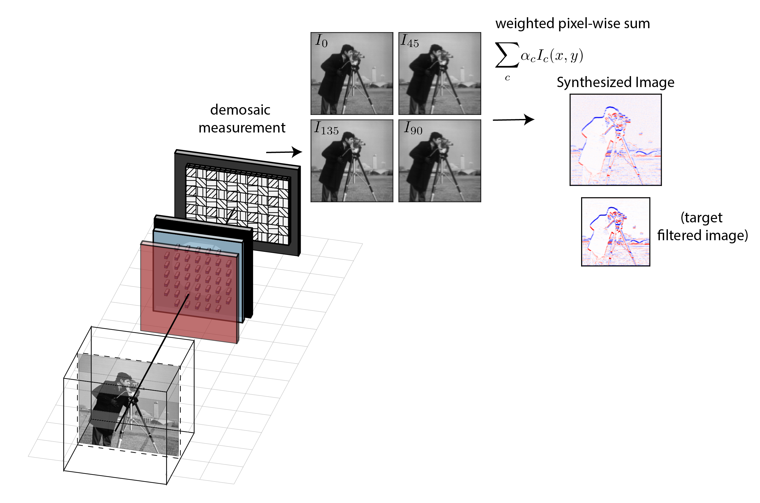
Applying the System: Multi-Image Synthesis Problem
metasurface
Proportion of energy in each imaging channel should be invariant to the scene
- Not true for spectral case
Motivations:
Unsolved Hardware: Compact and snapshot implementation of incoherent image processing for general scenes has not been achieved before
Motivations:
2) New Functionality: Prior works synthesize a single optical filter for single depth or wavelength
→ Problem cannot be solved with spectral coding and required transition to polarization
Create synthesized filters with prescribed depth or wavelength dependence (sparse optical cues)
Implement multiple filters only by changing the summation weights
Notes:
Given an understanding of this system and how to optimize the metasurface, we now want to demonstrate its usage by applying it to a new task introduced in this paper called Multi-Image Synthesis.
An overview of this design problem in its simplest form is depicted here. Given a scene, we desire an arrangement of nanofins on the metasurface which will produce some polarization-encoded intensity pattern at the photosensor. This intensity is then measured with the polarizer-mosaiced pixels and is digitally demosaiced to obtain a set of four distinctly coded images, I0, I45, I90, and I135 in a single exposure. We then compute only the linear pixel-wise sum of the four images with some learnable scalar weights alpha in order to obtain a new, synthesized image. This synthesized image can then approximate a spatial frequency filtered rendering of the scene, using only a minimum of 6 floating point operations per pixel regardless of the filtering kernel.
Now this problem is closely related to and is inspired by research on opto-electronic image processing that was started in the late 1960s. In contrast to their goals of only using optics to reduce the computational cost of filtering, we are interested in re-imagining this problem for two reasons.
The first is that implementing general opto-electronic image processing filters as shown here presents a previously unsolved hardware problem. A compact (as in a single lens) snapshot implementation that works for general scenes has not been achieved before. Moreover, it is a problem that cannot be solved with spectral coding and requires a transition to polarization. Specifically, if we are to subtract two or more images and cancel out signal, we need to be ensured that ratio of energy in each imaging channel is the same for any scene. This of course is not true in the spectrally coding case because there is no way to ensure that the amount of light emitted from all points in the scene is the same on the three wavelength bands.
Alternatively, this fact is true in our polarization system when the scene emits unpolarized light. It can also be enforced for any scene by adding a linear polarizer at the entrance of the system as shown previously! This idea is one of the key advantages of using polarization over spectral coding.
Our second motivation for this problem is that we can demonstrate new processing functionality never previously shown. Specifically, in the past, only a single optical filter, defined for a single depth or wavelength, was applied in the synthesized image which is not particularly useful.
In this work, we show that one can create synthesized filters that have a prescribed depth or wavelength dependence. In otherwards, the filter that is applied in the synthesized image depends on properties of the light that are not directly measured and thus this method can serve as technique to produce sparse optical cues. We also show that instead of applying a single filter, we can encode multiple filtering operations in the captured images and selectively apply them by only changing the summation weights.

Slide 10
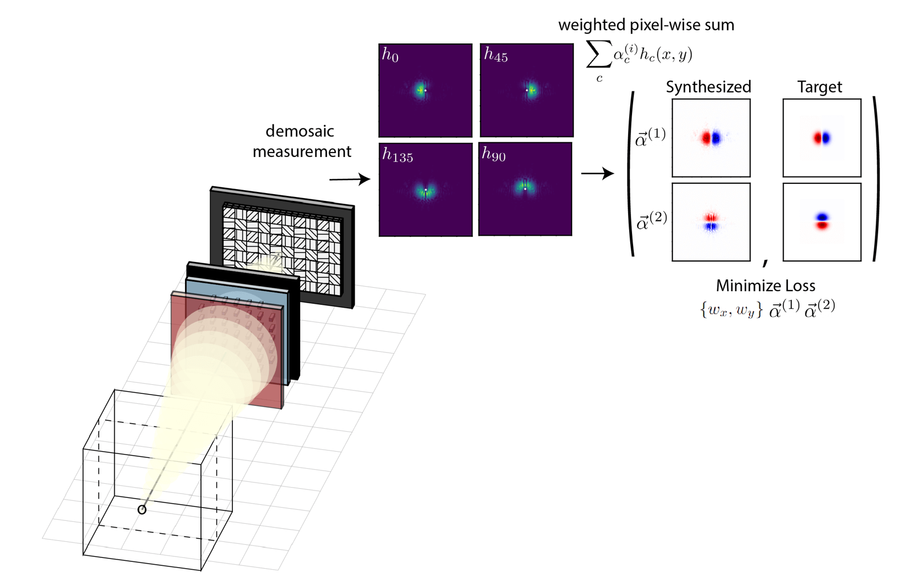
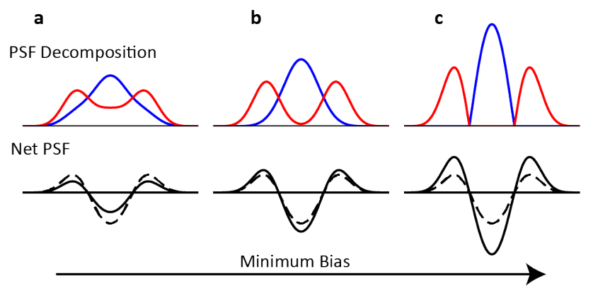
Multiple Filtered Images from a Single Exposure
Task: Achieve different filtering operations only by changing the digital summation weights
Minimize loss based on the point-spread function (PSF)
Note: Regularization is Crucial!
Enforce light efficiency
Minimum Bias Factorizations
Notes:
We now show some of the results from the optimizations for this task. We first begin with the case of applying different filters by changing only the digital summation weights. An important idea here is that the filtering operations encoded by our camera can be fully defined by specifying the point spread function. The point-spread function is the intensity produced and measured at the photosensor in response to an ideal axial point-source. In this case, we can simplify the task by assuming the point-source to be in the far-field and by considering monochromatic light. Because we have four polarization channels, we may say that our camera is characterized by a set of four point-spread function as shown here.
Moreover, we can then compute the linear, pixelwise sum of these four point-spread functions (like we did for the images in the last slide) in order to obtain a synthesized point-spread function. I wont derive it here but it is easy to check and see that the synthesized image mentioned before actually corresponds to an all in-focus (magnified) image of the scene convolved with this synthesized point-spread function. In other words, the this net PSF is analogous to the usual filtering kernel in computer vision and the convolutions are being done for free by the optics.
The design task can then be formulated by computing the loss between this synthesized point-spread functions, added through some sets of weights alpha1 or alpha2, and the target filters. In this case, we focus our attention to a class of steerable filters and desire one set of weights that yields the Gaussian derivative along one axis and a second set of weights that yields the derivative along the other axis. We then back-propagate gradients to optimize both the metasurface shape parameters and the summation weights.
Lastly, I want to highlight that a key part of solving this problem and a large part of this paper is directed to the topic of regularization. Besides enforcing light efficiency and avoiding the aforementioned case of light scattered outside of our simulation region, we also have deal with something known as minimum bias factorizations. The idea is that finding a set of four positive point-spread functions that can be added together to produce our positive-and-negative kernel is essentially a constrained matrix factorization problem. Although there are infinite solutions, not all are equally useful in real life. In the paper, we derive and introduce a new regularization term which basically says that if two point-spread functions are to be subtracted digitally, they should be orthogonal signals. Without doing this, it is likely that the filtering operation will not work when in the presence of measurement noise.

Slide 11
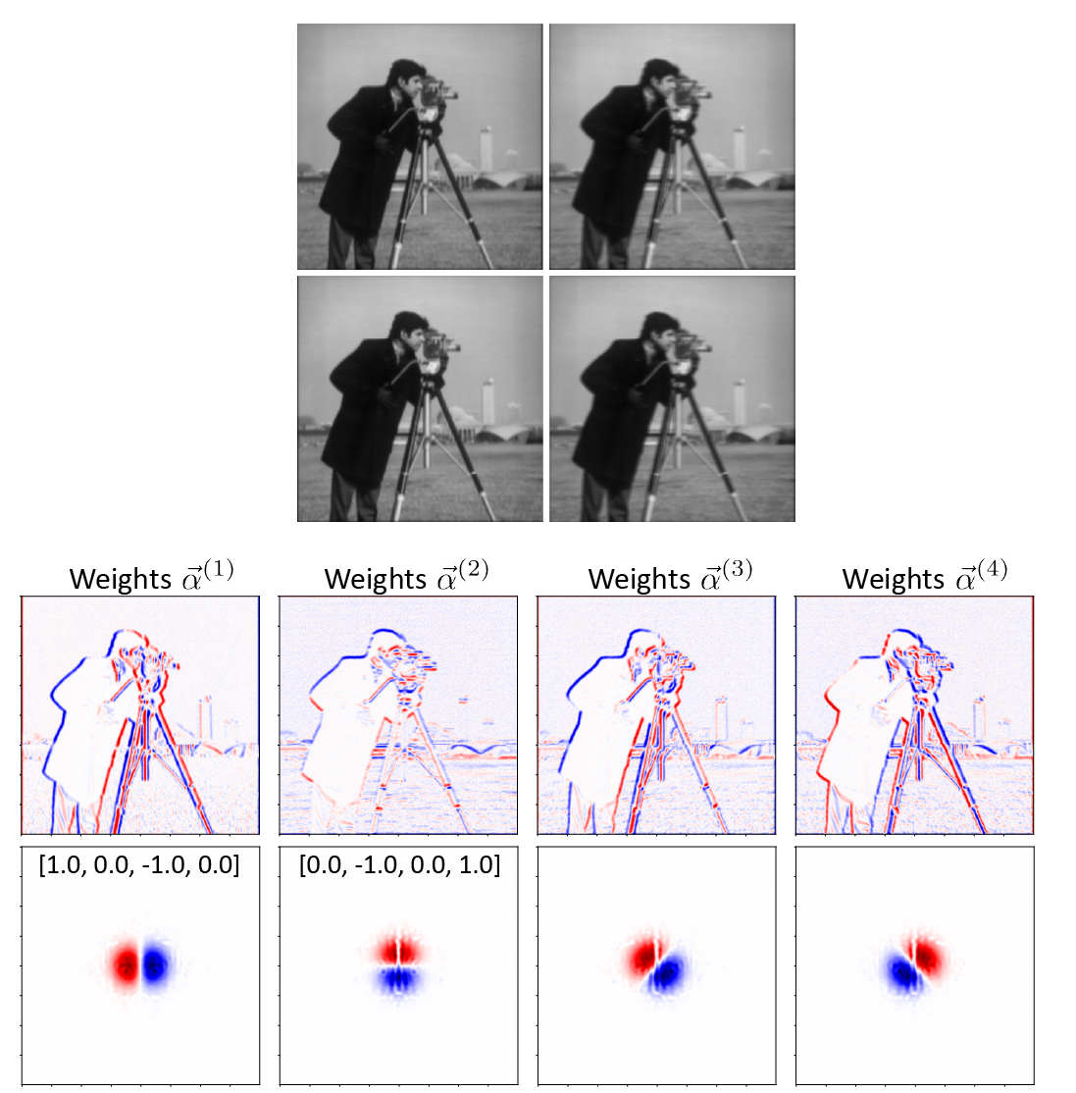
Multiple Filtered Images from a Single Exposure
Steerable Gaussian Derivatives
By changing the summation weights used to combine the four captured images, we can obtain the derivative along any orientation – at an absolute minimum computational cost
Notes:
After running the optimization, we then learn a metasurface like that shown on the left. The metasurface implements two different phase profiles, phix and phiy, which results in the set of four point-spread functions shown at the bottom. You can see it immediately but the camera has learned to encode the left and right halves of the gaussian derivative on the 0 and 90 degree polarized light. It also learns to produce, by leveraging the interference channels, the gaussian derivative along the y axis. The synthesized point-spread functions for the two explicitly learned summation weights alpha1 and alpha2 are shown to the right. The convenient property of this target filter pair is that when these two weights are defined, we automatically know the synthesis weights that results in the derivative along every other orientation angle.
We also display in simulation, what the four images captured on this system would look like for the camera-man scene. Notable the coding is subtle as it corresponds to a minor blur and a shift of the image by small distances. When these images are linearly combined however, we obtain the derivative of the scene at any angle that we choose and at an absolute minimum computational cost.

Slide 12
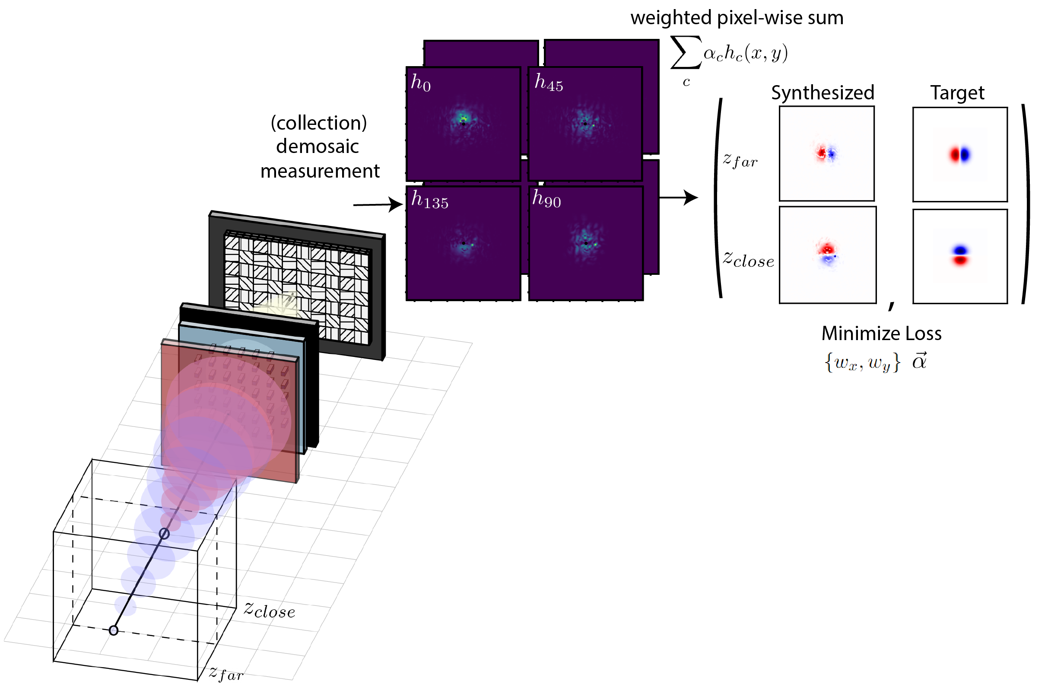
Depth Dependent Derivatives
Task: Orientation of the Gaussian derivative kernel to be dependent on object depth
Minimize loss based on the point-spread function (PSF)
Notes:
again using a loss based on the point-spread function, we also show that one can optically encode frequency filtering operations that have a prescribed depth dependence. In this case, we chose the task of producing a Gaussian Derivative with an orientation that rotates with depth. To do this, we consider a set of axial point-sources at different distances and compute the set of component point-spread functions and the synthesized point-spread function for each case. We then optimize for a single set of synthesis weights and a metasurface that minimizes the loss taken between the stack of synthesized point-spread functions and the target filtering kernels.

Slide 13
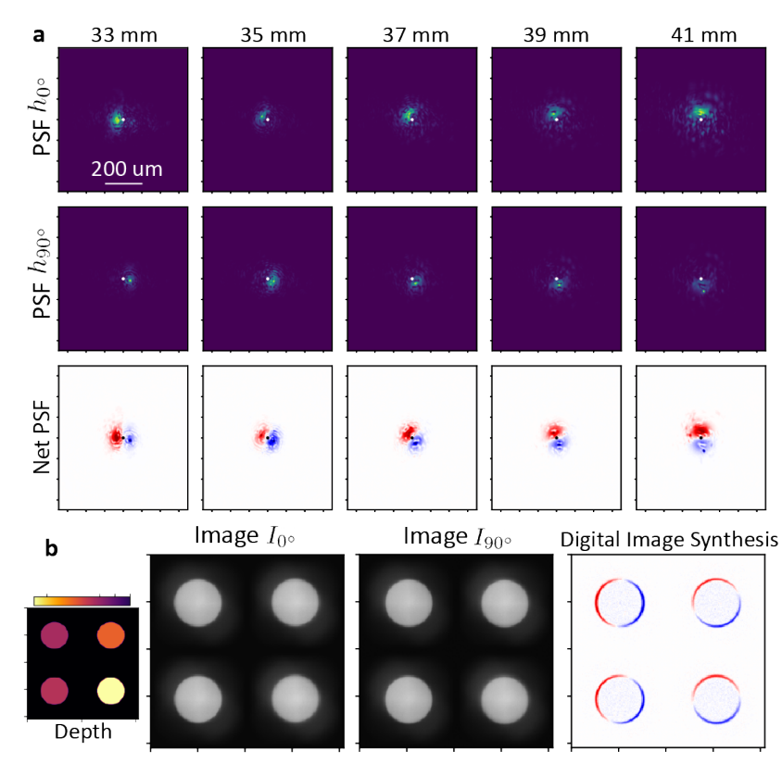
Depth Dependent Derivatives
Distance of light source
Different regions of the image have a different spatial frequency filter applied to it dependent on the depth map
Difficult to produce equivalent image purely digitally
Synthesis requires only 3 FLOPs
Notes:
And the results of this optimization are shown here. As a note, although we optimized over all four point-spread functions, the camera learns to use just a pair of images due to subtelties of the minimum bias regularizer. In otherwords, it learns to set certain terms in the alpha weights to zero which is actually the best solution for operating under noise. The two component point-spread functions are shown on the left for several distances within the optimization range and they synthesize an approximation to the rotating gaussian derivative filter.
On the right, we show in simulation the use of this camera for imaging a toy scene consisting of uniform intensity discs at different depths. By subtracting the two polarization-encoded images, we then obtain the digitally syhthesized image where each object in the image has a different orientation for the applied derivative. By identifying this orientation, we can easily estimate the distance of objects.
We highlight that producing an equivalent image using only digital processing of a standard camera image would be very difficult as it would require first computing a depth and segmentation mask. Alternatively, by optimizing our optics in this multi-image system, we obtain this result with a minimum of 3 FLOPs.

Slide 14
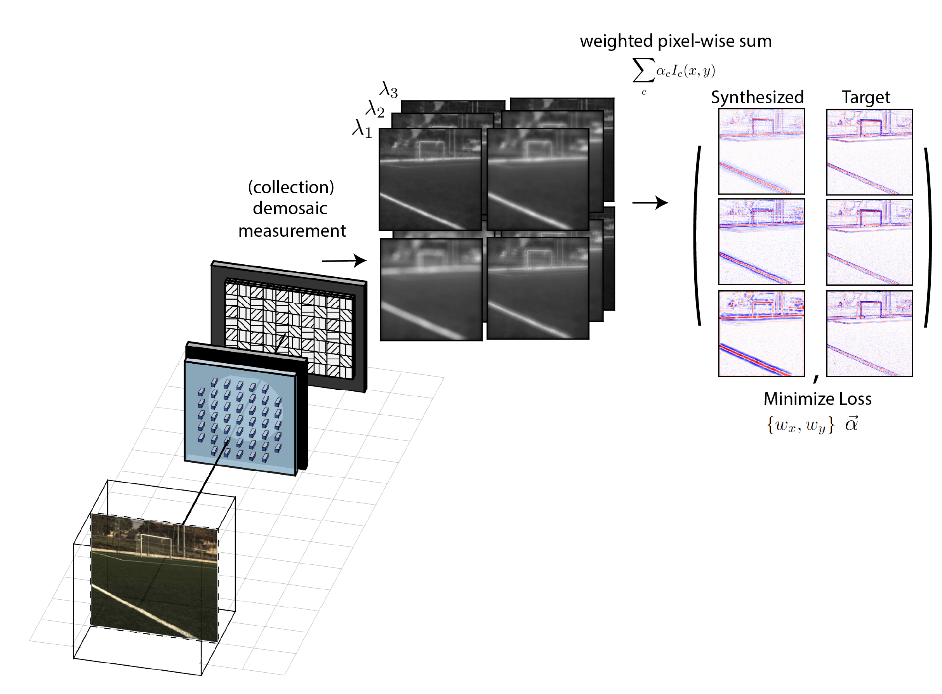
Engineering Synthesized Filters with Respect to Wavelength
Task: Synthesize image filtering kernels with a prescribed wavelength dependence
End-to-end optimization using a loss computed on images
Target in paper: Wavelength invariant operation
Simplest task that we are ensured is impossible to realize exactly
Learn the closest synthesized filters that approximate our target operations
Notes:
Lastly, we present on a method to engineer the synthesized filters with respect to wavelength. To successfully do this, we found it necessary to move away from a loss based on point-spread functions and instead use one based directly on the synthesized images.
Specifically, the optimization starts with a hyperspectral datacube describing a scene (projected here to rgb for visualization purposes). We then compute, for each wavelength channel in the considered range, the set of four component images that would be in addition to the corresponding synthesized image. We then compare these synthesized images to the desired filtered images which are specified by the user for each wavelength channel. This loss is then computed on the batch and minimized to learn the metasurface and the summation weights.
While there are many different wavelength targets we could have looked like, in this paper we actually focus attention to the task of producing a wavelength invariant Laplacian of Gaussian kernel. The reason is because a wavelength invariant filter is the simplest task that we are ensured is impossible to realize exactly. This principle of circumnavigating impossible requests is a key idea for this particular optimization algorithm. Although we know we cannot produce the underlying filtering kernel exactly, we aim to learn the closest set of synthesized filters that approximate our target operations. In other words, they are those that produce synthesized images with similar statistics to those underlying the target transformation.

Slide 15
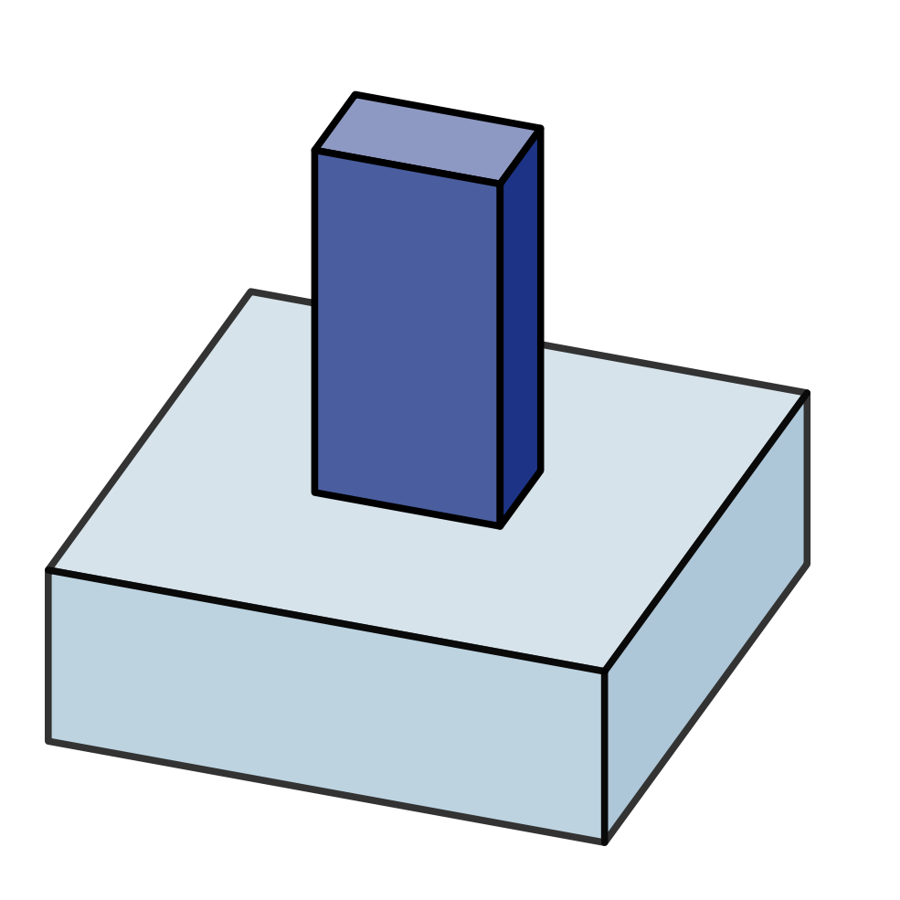
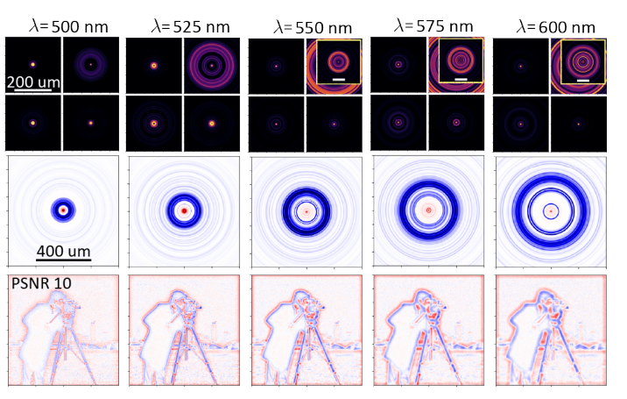
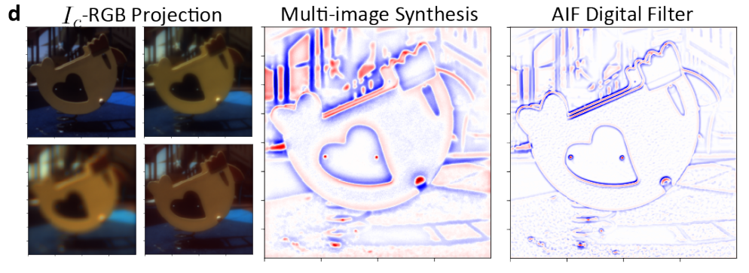
Engineering Synthesized Filters with Respect to Wavelength
Metasurfaces are dispersive
Synthetic Target:
Each nanostructure has a different wavelength dependent phase
→ Ability to optimize and control the set of PSFs with respect to wavelength
Zero-Shot Generalization (Arad1k dataset)
Notes:
Before I show some of the results, I first want to highlight for review why we know that a wavelength invariant operation is impossible. Besides the fact that field propagation from the metasurface to the photosensor is itself wavelength dependent, the biggest reason is due to the fact that metasurfaces are dispersive. We showed this before when we noted that the phase and transmittance imparted by a metasurface changes substantially with respect to wavelength as shown here. This feature of metasurface optics can actually be a useful thing however because it implies that we have some ability to structure the point-spread functions with respect to wavelength. At each location on the metasurface, we just need to find the nanostructure with the right wavelength dependence. In practice however, our control is rather limited and we are constrained to the set of dispersion curves like those shown in the slice from the nanofin dataset above.
Now for the optimization, we show in the paper that one can learn approximate transformations in the imaging system using a single synthetic datacube for the scene radiance during training. In this case, we use the cameraman image which emits light equally on all wavelength channels in the optimization range. Running the optimization, we then learn a set of component PSFs and synthesized point-spread functions which are clearly not Laplacian of Gaussian kernels but ultimately produce a similar effect to edge detection as shown on the bottom panel.
Lastly, we show that this learned lens can then be applied in a zero-shot setting to real hyperspectral scenes, using the radiance data from the Arad1k hyperspectral dataset. Of course the results can be substantially improved by using a real dataset during training.

Slide 16
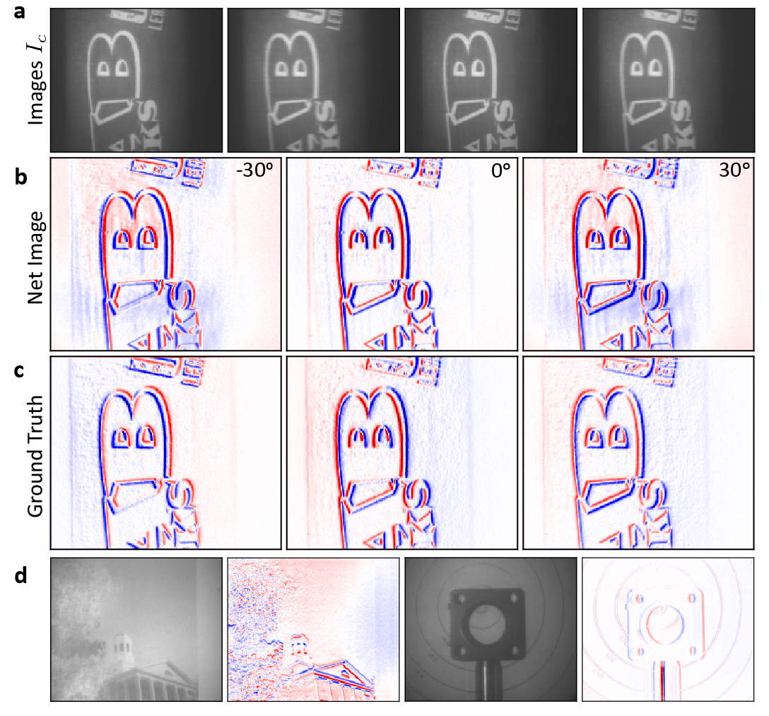
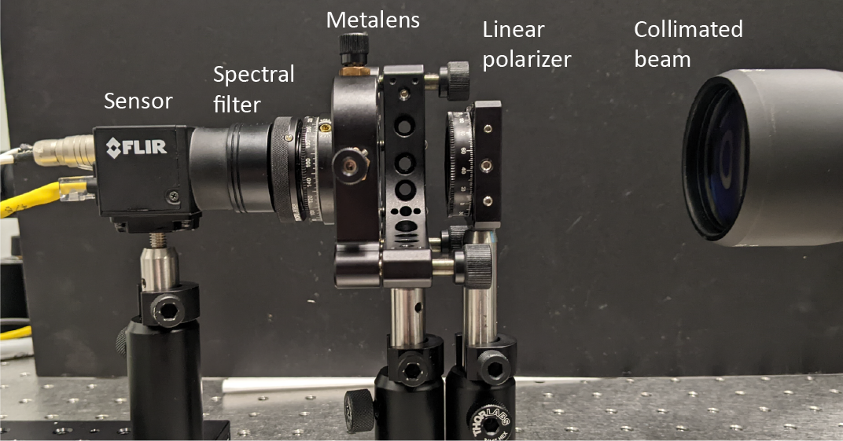
Validation of Design Theory with Prototype Camera
Metasurface
Off-the-shelf polarizer-mosaiced sensor
(Linear polarizer if we can’t assume unpolarized light)
(Spectral filter if we are testing single wavelength)
Notes:
Finally, I want to highlight that while most of this talk has presented simulated results, we did validate the camera architecture and the design principles by building a prototype system as shown here. The camera includes an off-the-shelf polarizer-mosaiced photosensor. We then fabricated and tested two different metasurfaces as shown in the center and found close agreement between the set of four extracted point-spread functions and the simulated intensities.
Using the lens that implements the steerable gaussian derivative, we also capture images of various targets as shown on the right.

Slide 17
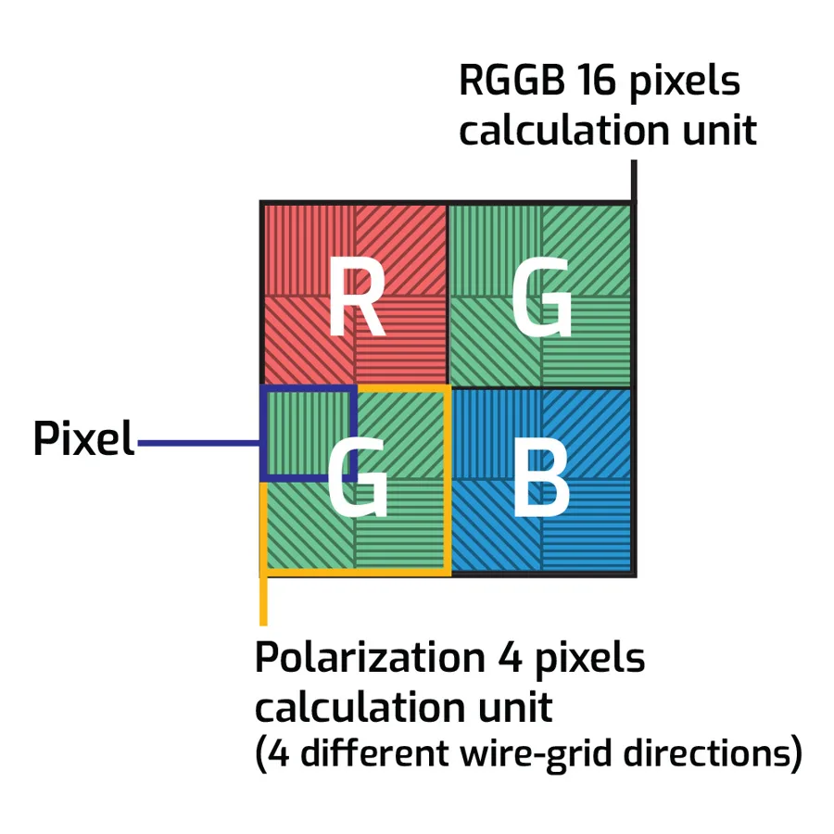
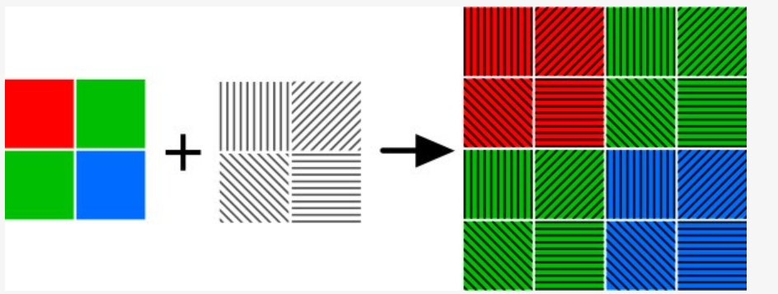
Conclusions and Future Remarks
Take-Aways:
Metasurfaces excel at polarization (and wavelength) transformations
Polarization, like wavelength, can be used as distinct multiplexed imaging channels
Metasurfaces designed for multi-coded imaging can minimize/reduce computational costs
Future Remarks: Polarization and Spectral multi-coded systems are not mutually exclusive!
Future systems can combine the two (metasurface is still ideal)
Limitation of spatial resolution → Improved by smart demosaicing using learned statistical priors
Optimize the capture of 16 distinctly coded images in a single snapshot
Notes:
In conclusion, we highlight a few take-aways:
First, metasurfaces excel at polarization (and to a lesser extent) wavelength transformations and can be useful for multicoded imaging systems.
Moreover, polarization like wavelength can be used as distinct multiplexed imaging channels and in this talk, we discussed the channel capacity
Lastly, metasurfaces designed for multi-coded imaging systems have the potential to minimize or reduce the computational costs for a wide range of tasks
Regarding the future, It is also worth emphasizing that the ideas of polarization and spectral multi-coded imaging are not mutually exclusive although we presented it in such context in this paper.
Specifically, commercially available cameras combine the two and pair the mosaic of linear filters with the RGB bayer filters as shown below.
This presents an interesting future avenue of research and metasurfaces would still be an ideal optic to design.
Notably, the main limitation of this technique is a limitation to spatial resolution however it is well known that this can be fixed by smarter algorithms and demosicing networks leveraging statistical priors.
And by combining polarization and spectral coding with such filter arrays, it is then possible to simultaneously capture 16 distinct images in a single snapshot. What researchers choose to do with all those images is left to be seen.

Slide 18
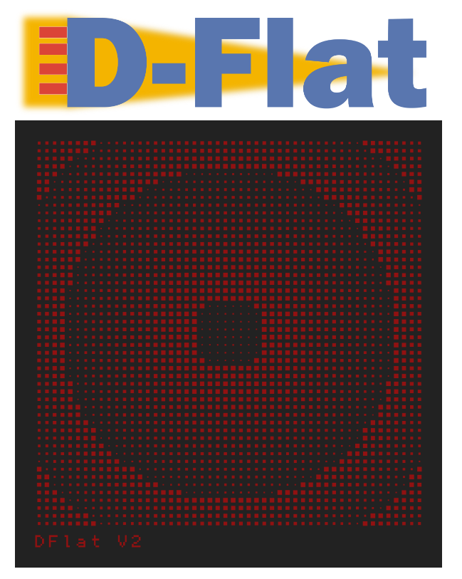
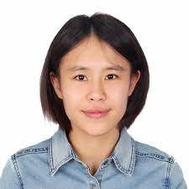
Thanks for listening
Open-source Auto-differentiable design framework (Tensorflow, Pytorch)
Share metasurface cell libraries
Pre-trained implicit Representations (MLP, ERBF, Multivariate-Poly)
Field Propagation (Hankel + FFT; Angular Spectrum, Fresnel, Exact)
Scene rendering operations (convolutional, noise)
field solver (RCWA)
Special Thanks:
Mia Polansky
Aneel Damaraju
Dr. Zhujun Shi
Notes:
Thanks for listening to this talk. If you have additional questions or thoughts, feel free to email the authors.
Also note that all the code used for this work is made available in addition to an open-source inverse design software called Dflat. Dflat is built on both Tensorflow and Pytorch and provides a repository for auto-differentiable implementations for the full end-to-end design pipeline. You can access it on github by scanning this QR code or by clicking on the links in this page.

Slide 19
Supplemental Slides

Slide 20
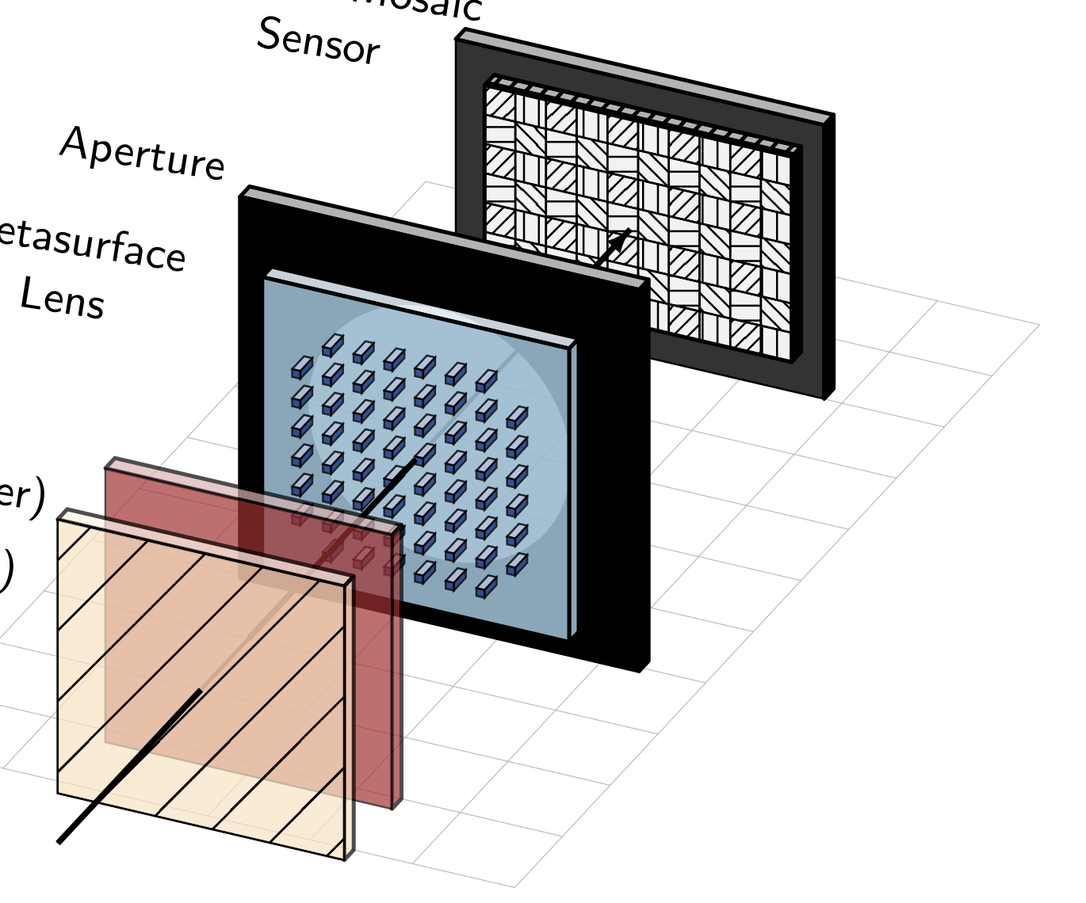
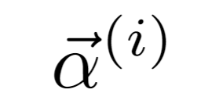
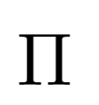
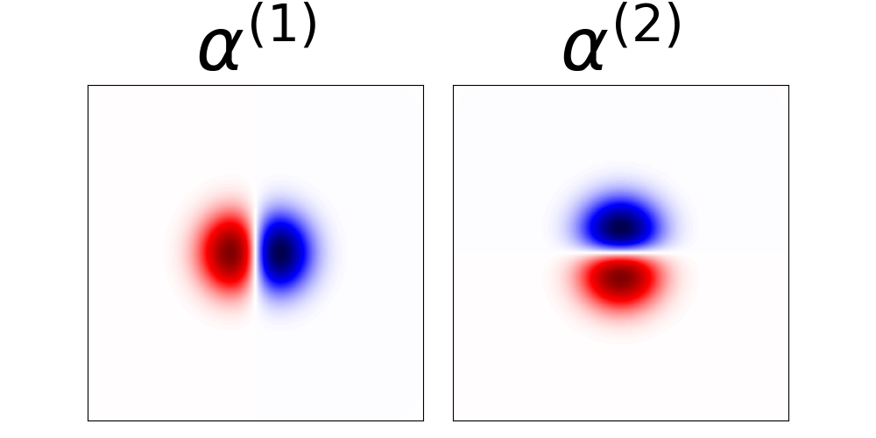
Supplemental Slides
Gradient Descent With Regularization
Synthesis weights
PSF decomposition as a constrained, non-negative matrix factorization problem:
The set of four PSFs (columns of $H$) are parameterized by metasurface $Π$
Additional coupling by interference between different polarization channels
Not all factorizations are equally useful in the presence of noise!
Metasurface
Filter-Target Objective
Regularizer :
Enforce light efficiency & the PSFs to be spatial compact
Minimum Bias Factorizations
Image-Target Objective

Slide 21
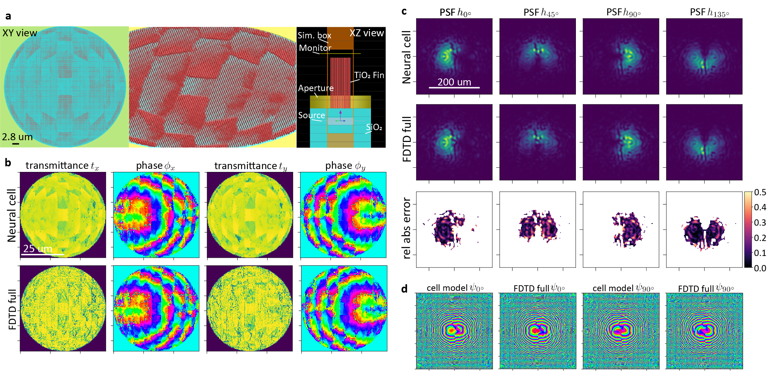
Supplemental Slides
Validation of the Cell Design Principle with Full Lens FDTD Simulations

Slide 22
Slide Variants

